Slide 1
Normal vs PD
40
Normal
30
PD
Firing Rates
20
10
0
1
2
N
c
r
SN
D
D
i
SN
F
ST
p
MSN
MSN
ty
to
Arkypallidal
o
Pr
Normal vs PD
40
Normal
30
PD
Firing Rates
20
10
0
r
1
2
N
c
SN
D
D
i
SN
F
ST
p
MSN
MSN
ty
to
Arkypallidal
o
Pr
Neuron

Slide 2
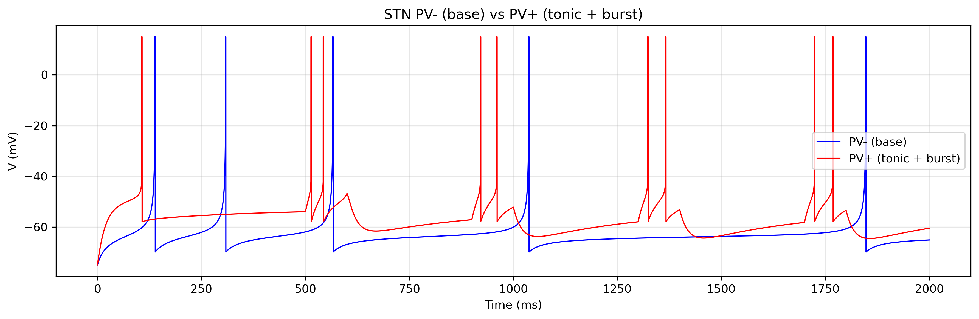
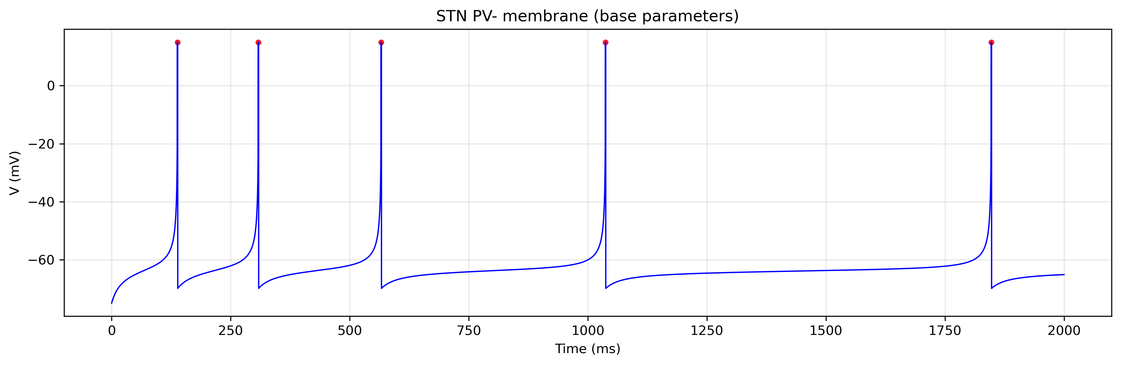
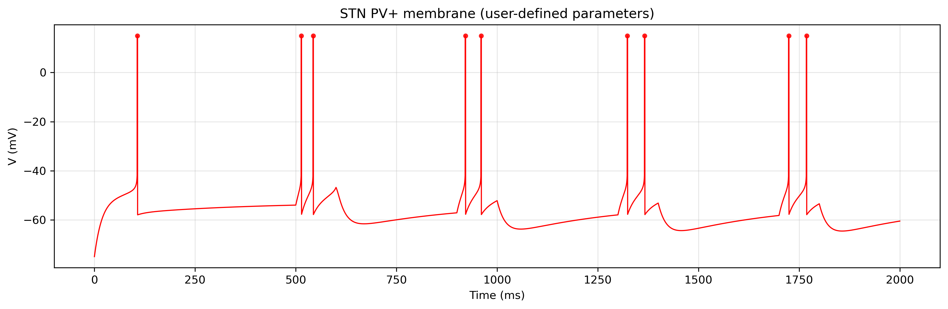

Slide 3
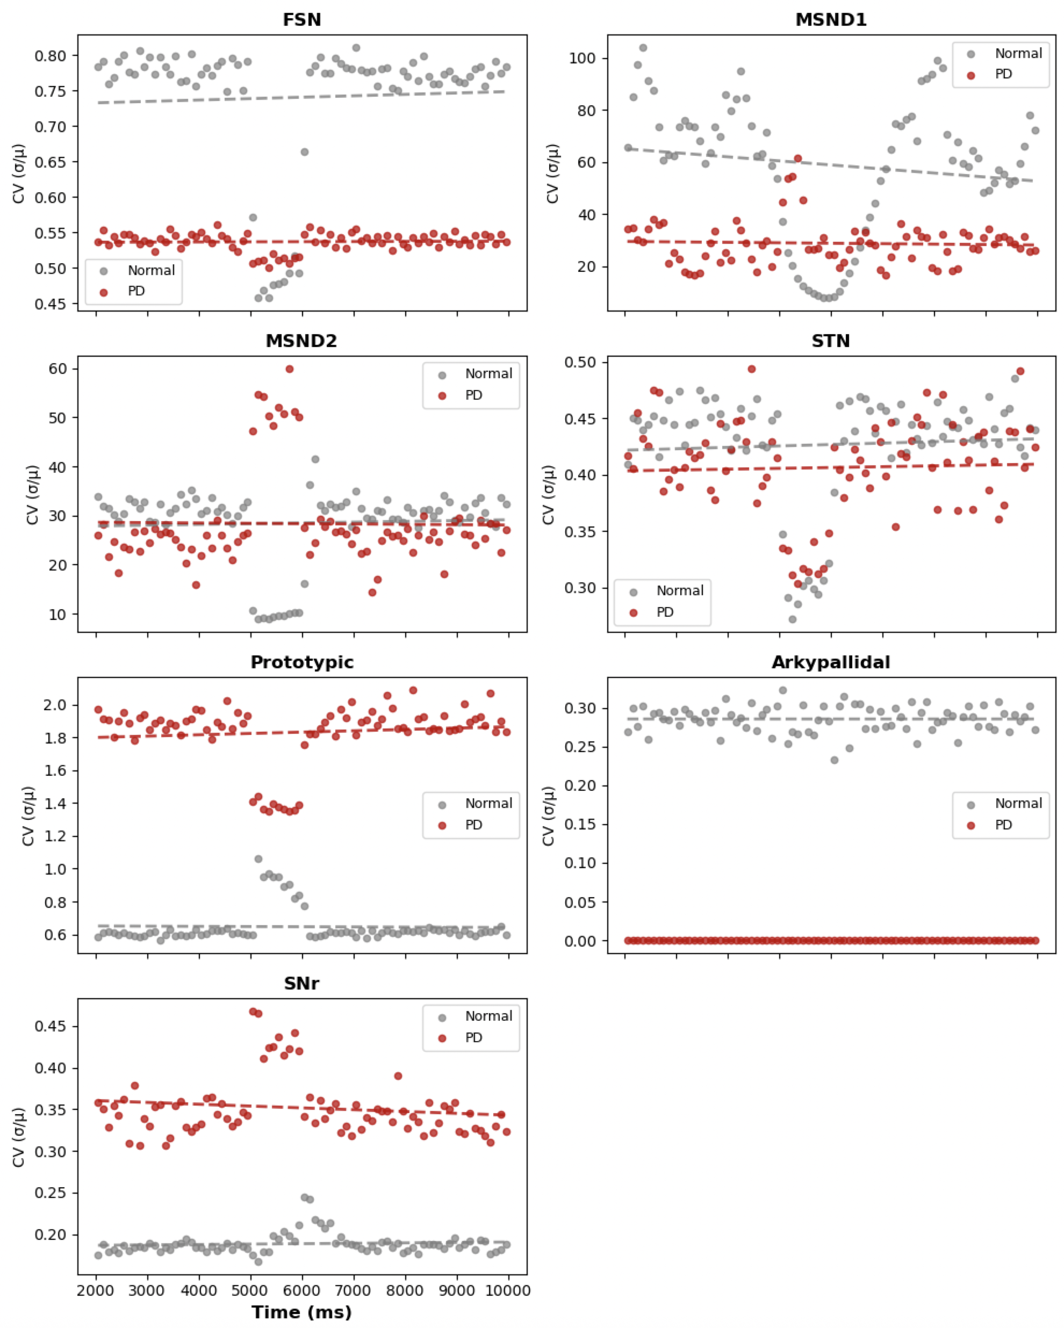

Slide 4
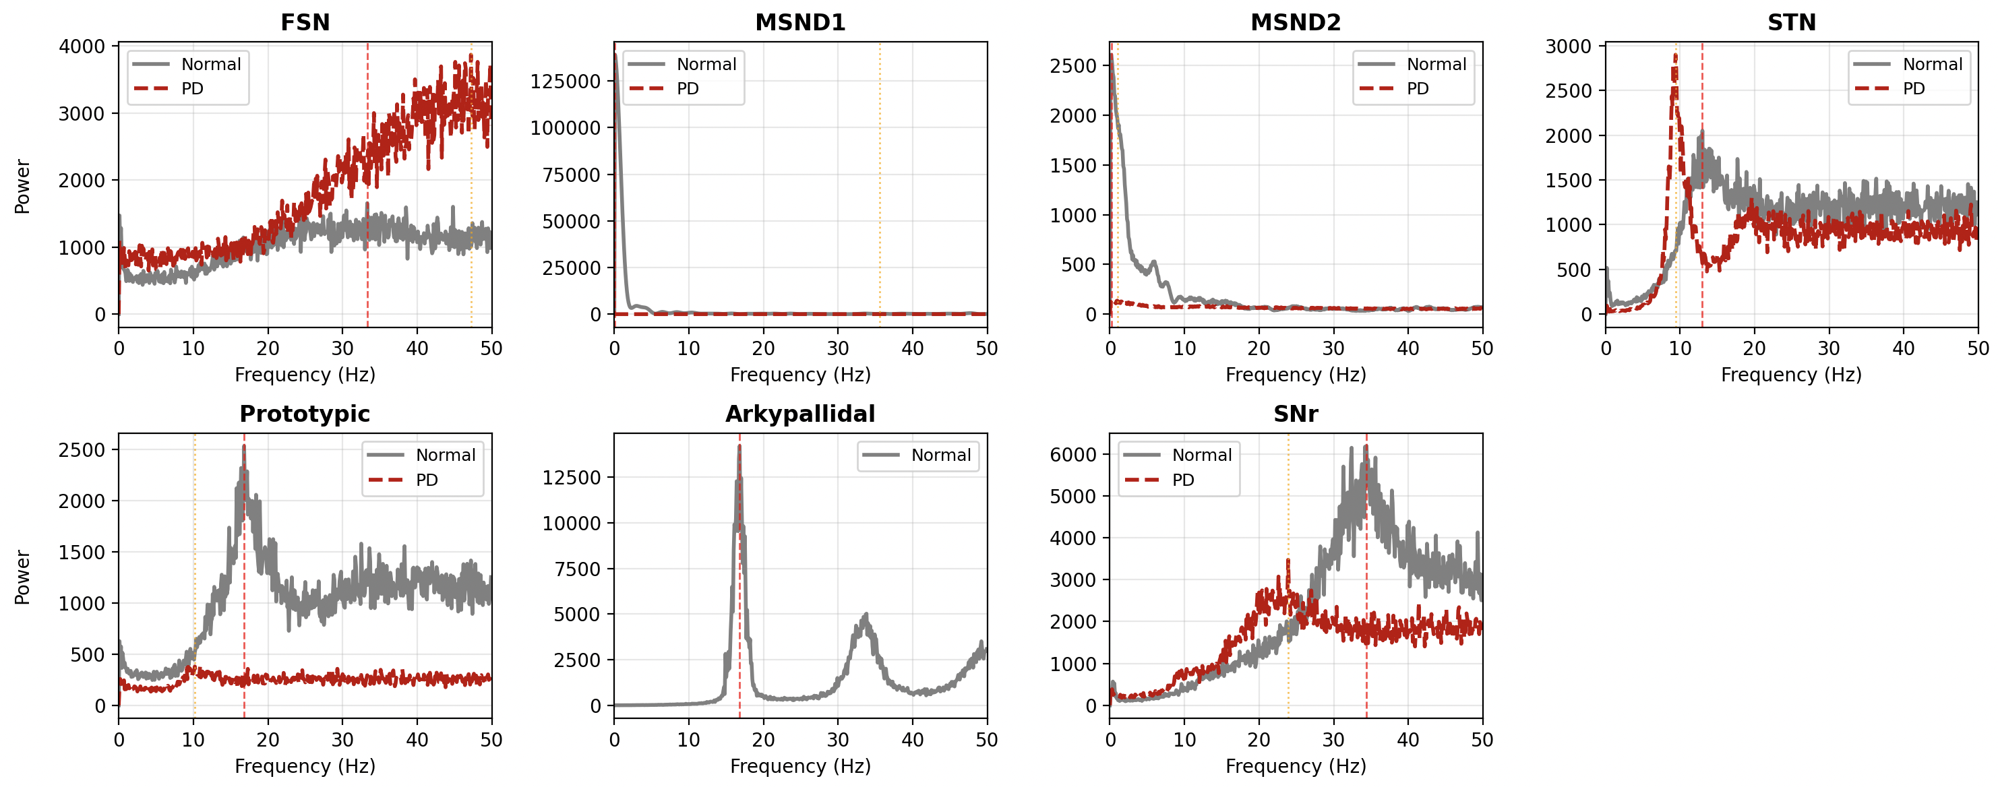

Slide 5
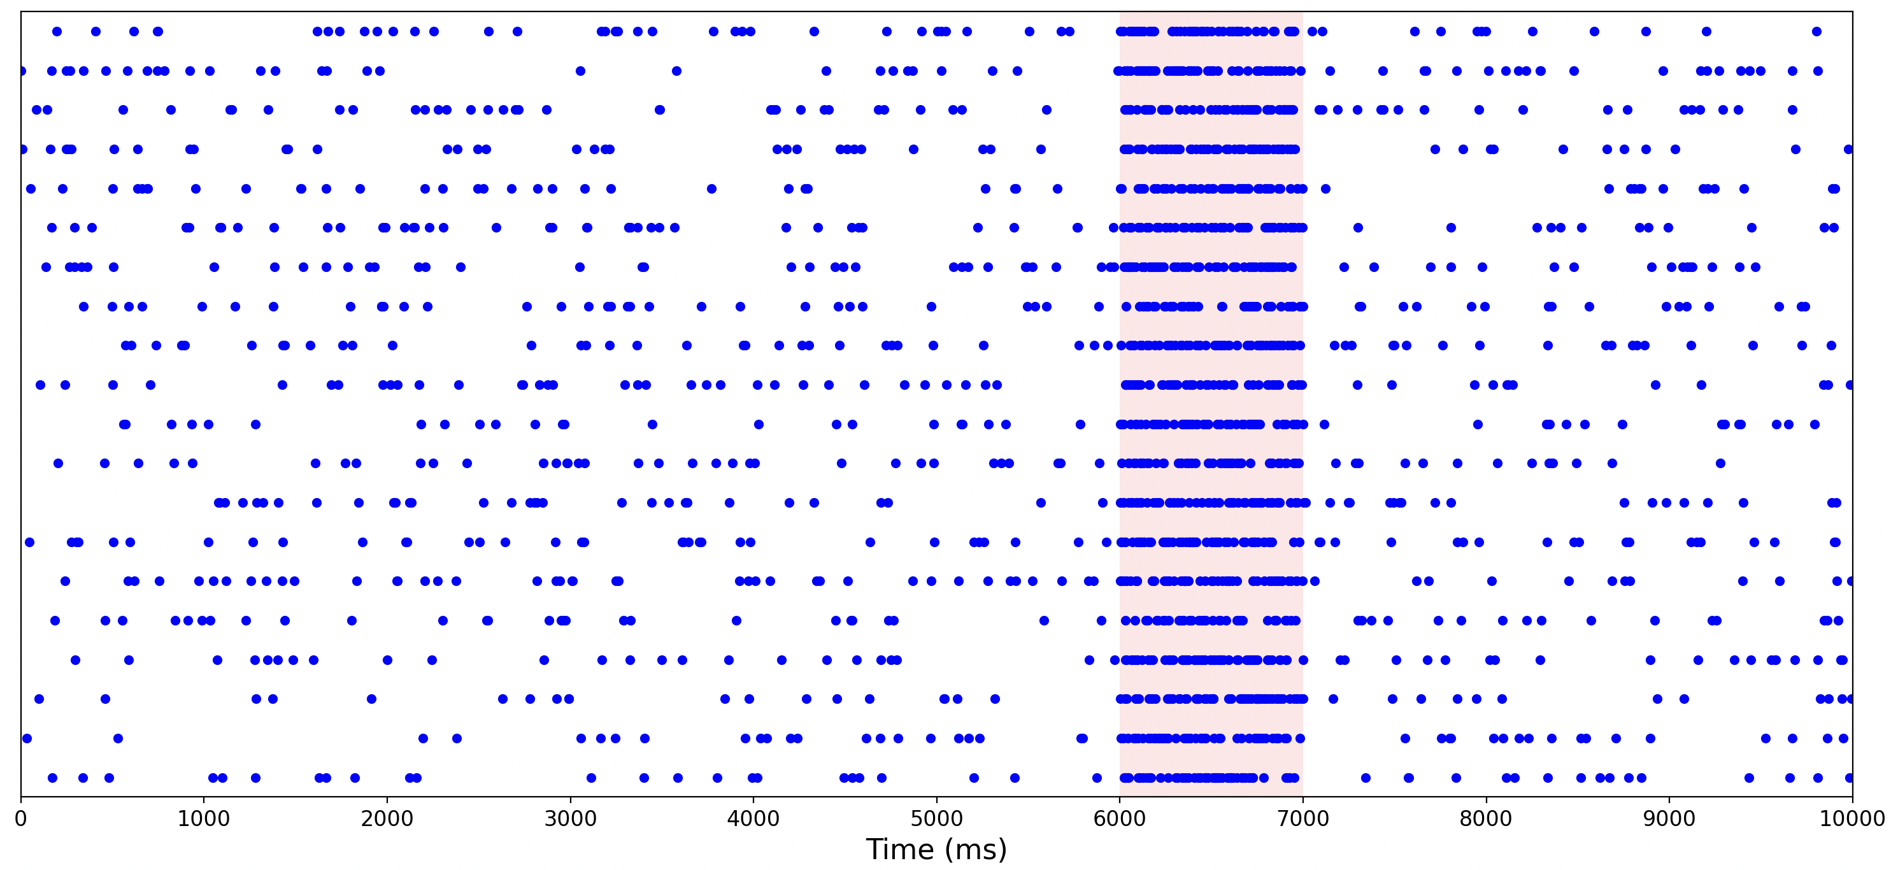
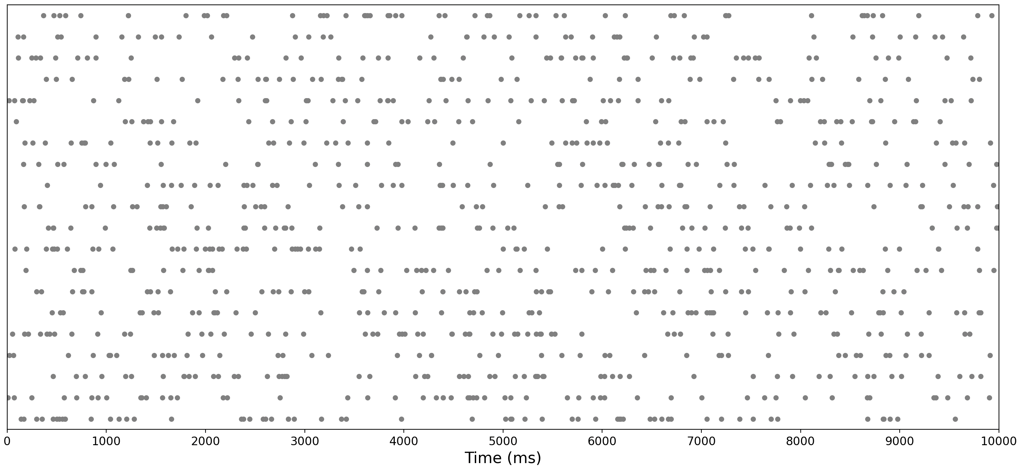

Slide 7
